Slide 1

Web Scraping of a Real Estate Website and Data Visualization
By Ravi Yernena

Slide 2

Objective:
For a better ROI in Real Estate Investment in AZ
Where to invest
which property type to choose
Cap Rate and Price Correlation

Slide 3

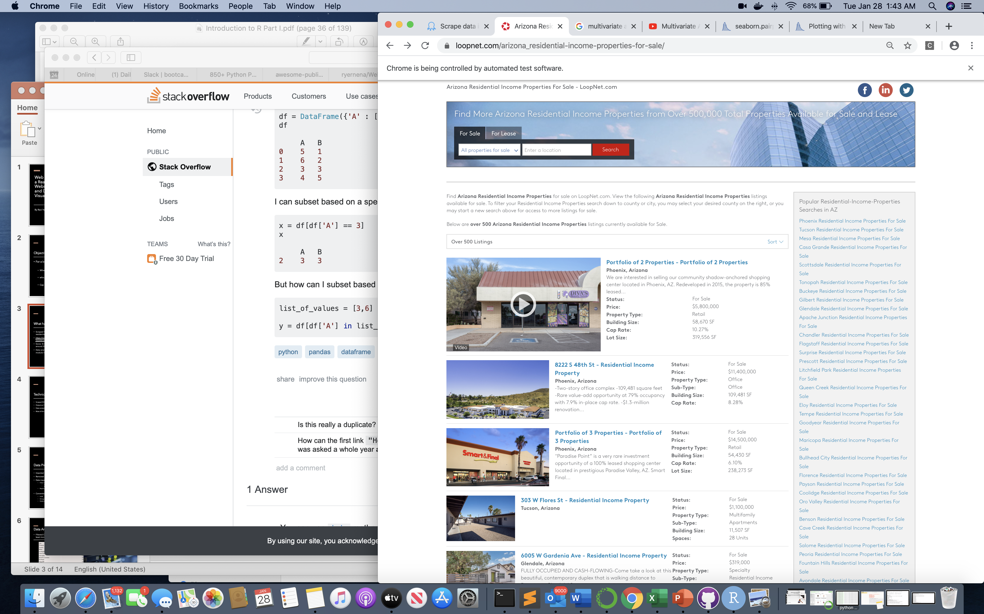
What have I done:
Scraped https://loopnet.com website for residential investment properties in the state of AZ
https://www.loopnet.com/arizona_residential-income-properties-for-sale/
Gone through each of the listing on every page, around 20 pages - by Selenium
Data wrangling and visualization by Pandas module in Python

Slide 4
Technical Outcome:
Scraped 500 listings form 20 pages
Output as CSV format
Data consist of 500 rows and more than 27 columns
Most of the data columns are either incomplete or inconsistent

Slide 5
Data Preparation:
Imported into Python
Removed unwanted columns
Data massaging
Filled in null values from and from
Values of other columns
Random values
Replaced and removed special characters
Converted data types into suitable formats for analysis:
Int64
Strings
Datetime

Slide 6
Data Analysis
City | Listing Count
Phoenix | 108
Tucson | 52
Mesa | 35
Scottsdale | 25
Casa Grande | 23
Glendale | 13
Apache Junction | 12
Buckeye | 12
Flagstaff | 12
Surprise | 11
Gilbert | 11
Tempe | 11
Chandler | 11
Cities with highest number of listings, at least more than 10 listings per city
+
Top 7 categories of Property Types that are listed
Type of Property | For Sale
Residential | 88
Apartments | 38
Commercial | 35
Retail | 24
Office | 21
Freestanding | 19
Medical | 19

Slide 7
Data Analysis
Variables for analysis
Price (USD)
City
Type of the property
Cap Rate (% per annum) -- Target Variable

Slide 8
Data Insight: Highest number of properties for sale
Phoenix
Tucson
Mesa
Scottsdale
Casa Grande

Slide 9
Data Insight: Highest number of types of properties for sale
Residential
Multifamily/Apartments
Commercial
Retails
Office
Medical
Freestanding

Slide 10
Data Insight:
Median price of the property by City
Mean price of the property by City

Slide 11
Data Insight:
Median price of the property by property type
Mean price of the property by property type

Slide 12
Data Insight:
Cap Rate by City and Property Type

Slide 13
Data Insight:
Cap Rate by: City + Property Type

Slide 14
Data Insight:
Cap Rate by : City + Price Range
A= 0-$250k, B=$250-$500k, C=$500-750K, D=$750-1000k, E=$1000-2000K,F= >$2000K

Slide 15
Conclusion
More work to be done to reach a conclusion
Need to get a complete dataset

Slide 16
Questions?
And
Thank You

